Slide 1

Global Weather Risk Analysis For Active Vane Freezing
Using Global Weather Station Data (2005–2025) By Rayyan Taimuri
GSOD NOAA Global Surface Summary of the Day Weather Data.

Slide 2
Project Overview
Modern Jaguar vehicles are equipped with active vanes that open and close to optimize aerodynamic performance and assist in cooling the front of the car. However, under certain environmental conditions—particularly freezing weather—these vanes can become stuck, impairing their function and potentially affecting vehicle efficiency and safety.
This project investigates weather conditions that may lead to vane freezing, aiming to identify high-risk scenarios that could compromise vane operation. Understanding these conditions is crucial for improving data quality, vehicle design, and instrument maintenance.

Slide 3
Objective
To develop an interactive map and dashboard that visualizes the proportion of days at each weather station where environmental conditions suggest a risk of vane freezing.
This tool will help users quickly identify locations and time periods where freezing conditions are most likely to occur, based on historical weather data. It provides a visual and quantitative way to assess environmental risk to active vanes, supporting better design decisions and maintenance planning.
The dashboard enables users to:
1. Explore how frequently freezing conditions occurred over a 21-year period (2005–2025).
2. Identify geographic patterns and seasonal trends.
3. Assess risk levels across different countries, elevations, and climates.
This tool is especially valuable for engineers, analysts, and designers seeking to quantify environmental risks and improve the resilience of active vane systems.

Slide 4

User-Selectable Filters
The dashboard includes a range of filters that allow users to customize the criteria for what constitutes a “relevant” day. These filters include:
1. Maximum Temperature (°C)
Range: -51°C to 60°C
Purpose: Helps identify days with extreme heat or cold, especially relevant for freeze-thaw cycles.
2. Minimum Temperature (°C)
Range: -63°C to 42°C
Purpose: Critical for identifying freezing conditions, especially overnight lows.
3. Precipitation (mm)
Range: 0 to 100 mm
Purpose: Indicates moisture availability, which is essential for ice formation.
4. Average Daily Temperature (°C)
Range: -54°C to 44°C
Purpose: Gives a general sense of the day’s thermal profile, useful for identifying borderline freezing days.
5. Dew Point (°C)
Range: -60°C to 33°C
Purpose: Helps assess humidity and condensation risk, which can lead to frost or ice.
6. Elevation (Binned in 100s of Metres)
Purpose: Elevation affects temperature and weather patterns. Higher elevations are more prone to freezing.
7. Country
Purpose: Enables geographic filtering to compare conditions across different regions.
8. Season
Purpose: Allows seasonal analysis (e.g., winter vs. spring), which is key for understanding when freezing risks are highest.

Slide 5
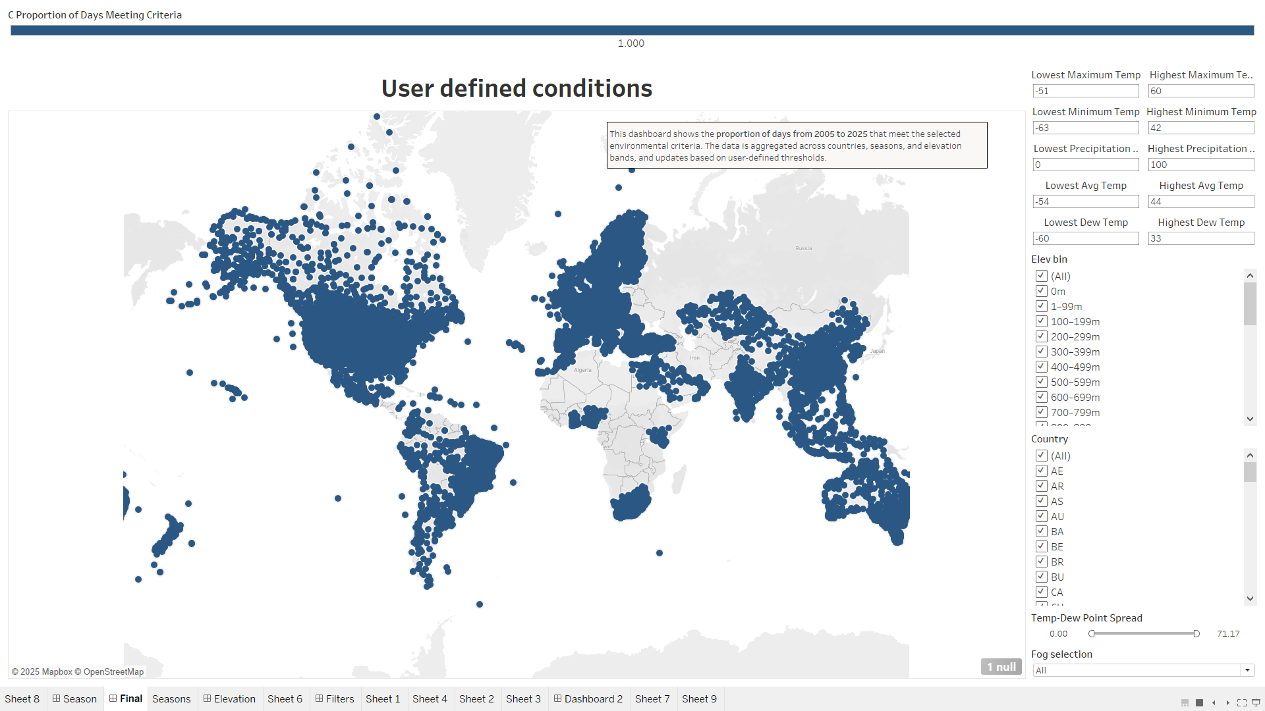
No conditions have been selected, which is why the proportion is currently shown as 1 for all weather stations globally

Slide 6
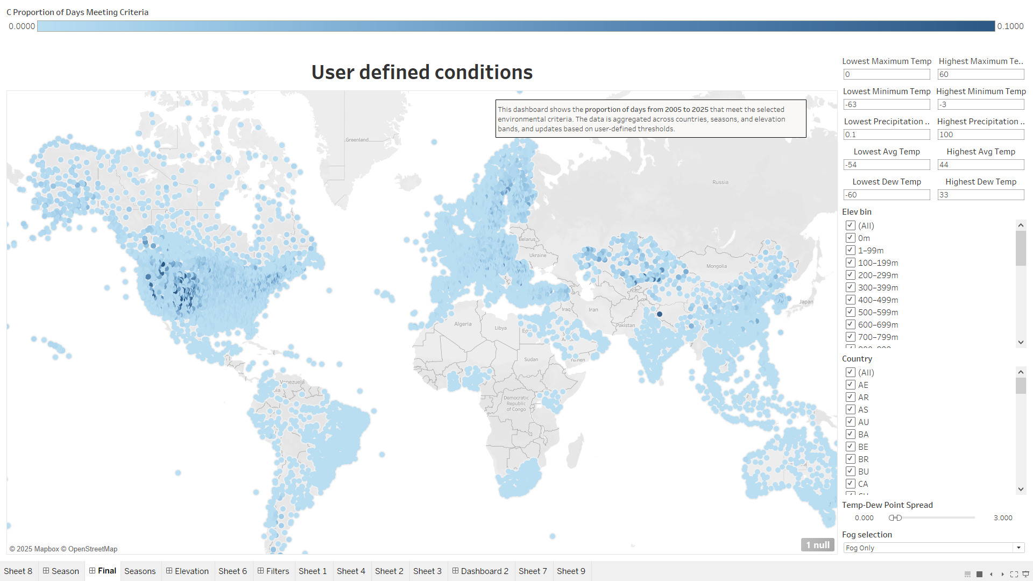
Selecting different conditions from the right-hand filters will update the map accordingly

Slide 7

Pre-defined map conditions
1. Max Temperature > 0°C AND Min Temperature < -3°C
Why this matters: This range indicates daytime temperature variation. Where it’s warm enough during the day for moisture to accumulate (e.g., rain, dew), but cold enough at night or early morning for freezing to occur.
Risk: Water may melt during the day and refreeze overnight, potentially causing vanes to stick or freeze in place.
2. Precipitation > 0 mm
Why this matters: Any form of precipitation (rain, sleet, snow) introduces moisture into the environment.
Risk: If temperatures drop below freezing, this moisture can freeze on surfaces, including vanes.
3. Fog = Yes
Why this matters: Fog consists of tiny, suspended water droplets in the air.
Risk: These droplets can condense and freeze on cold surfaces, especially when temperatures hover around 0°C — a phenomenon known as rime icing.
4. Dew Point < 0°C
Why this matters: The dew point is the temperature at which air becomes saturated, and water vapor condenses.
Risk: If the dew point is below freezing, any condensation that forms will likely freeze, leading to frost or ice accumulation.
5. Temperature – Dew Point Spread ≤ 3°C
Why this matters: A small spread between temperature and dew point means the air is nearly saturated.
Risk: This increases the likelihood of condensation, and if the temperature is near or below freezing, that condensation can turn to ice.
Summary: Why These Conditions Together?
These criteria are designed to capture the most likely scenarios where:
Moisture is present (precipitation, fog, dew).
Temperatures are near or below freezing.
Conditions are right for ice formation, especially on exposed vehicle components like vanes.
This combination is more precise than just looking at sub-zero temperatures, because it accounts for moisture availability and freezing potential, which are both required for vanes to freeze.

Slide 8
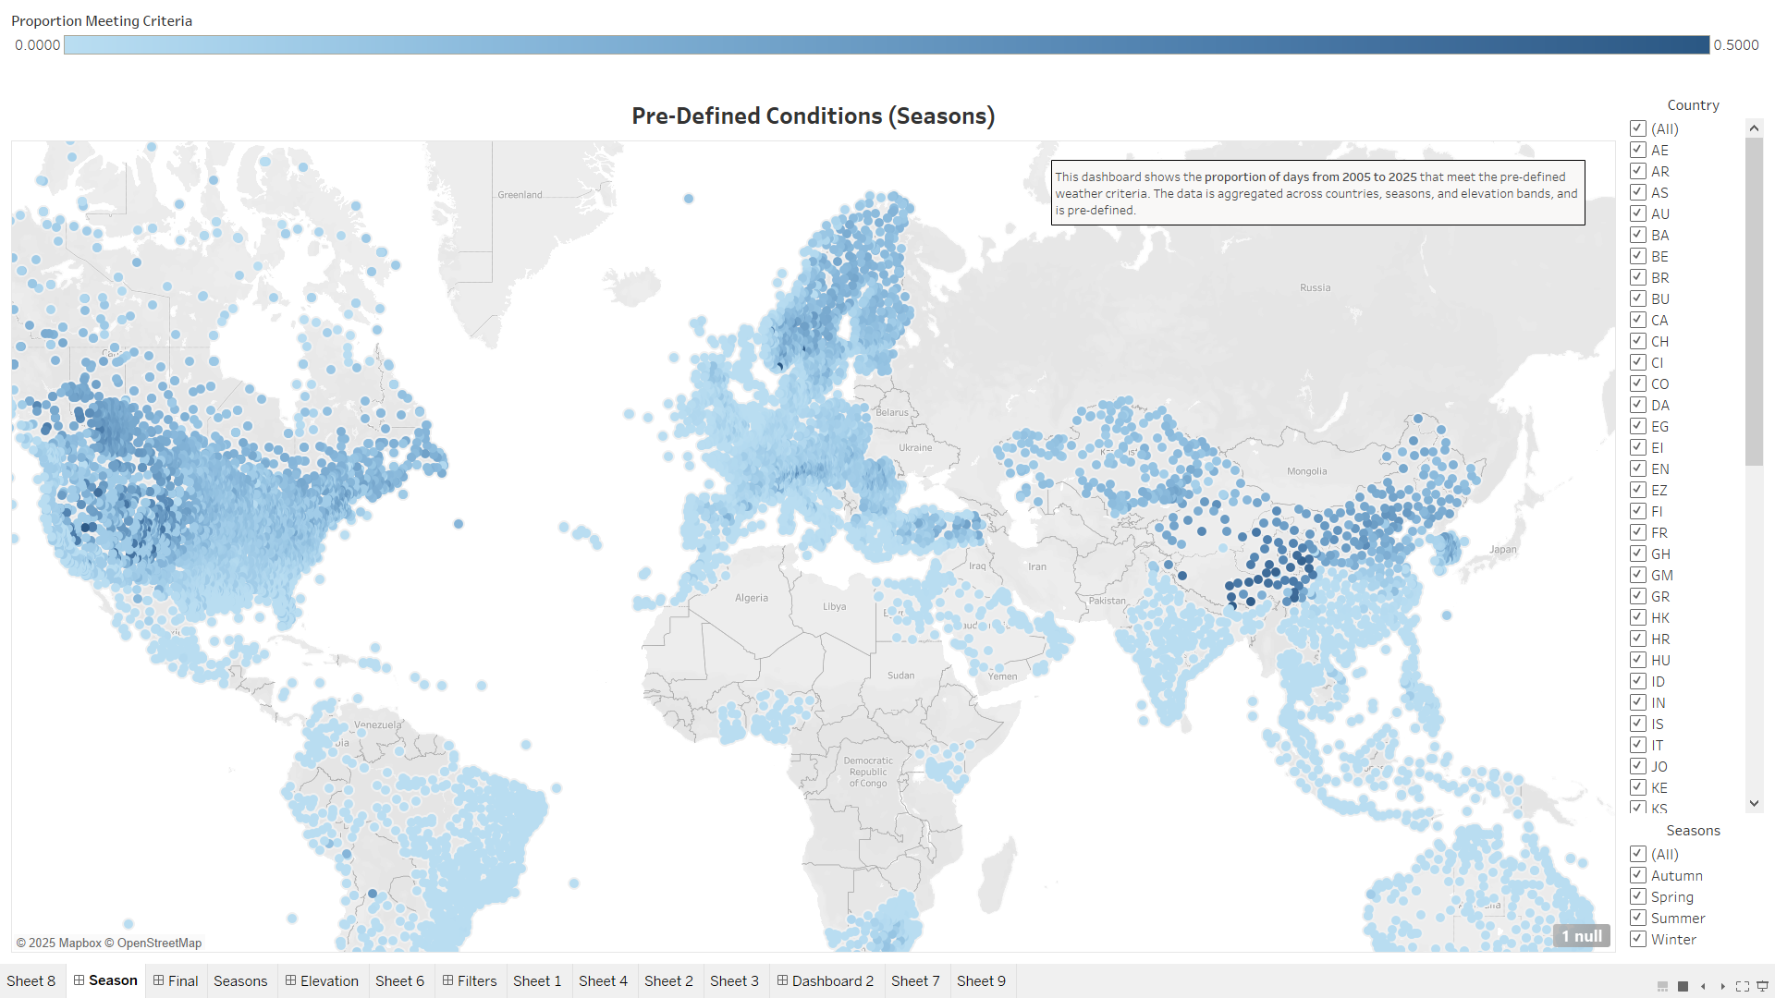

Slide 9

Insights
📊 Weather Station Data Summary
Total Weather Stations Analysed: 13,100
Recording Duration:
Varies significantly across stations.
Some stations have only 1 day of data, while others have up to 7,429 days (from 01/01/2005 to 04/05/2025, inclusive).

Slide 10
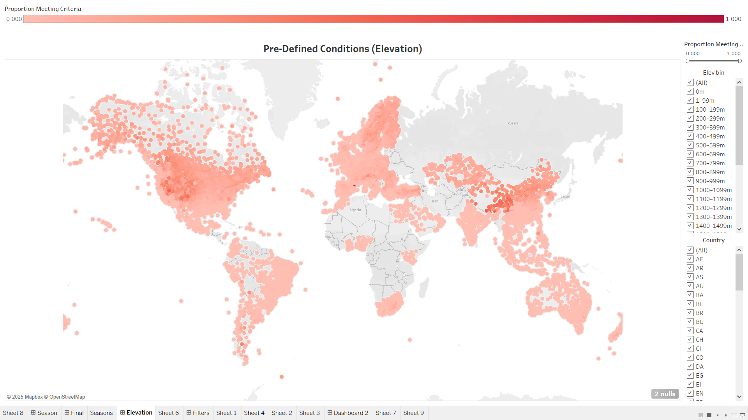

Slide 11
Insights
🟨 Stations with High Event Frequency
35 stations recorded ≥40% of days with relevant weather conditions.
Only the 19 locations in China have over 10 years of data.
These Chinese stations are all above 2500m in elevation. These are not locations where JLR cars will be sold.
The remaining stations have between 3 days to 5 years of recordings.
📌 See Slide 13 for details.

Slide 12
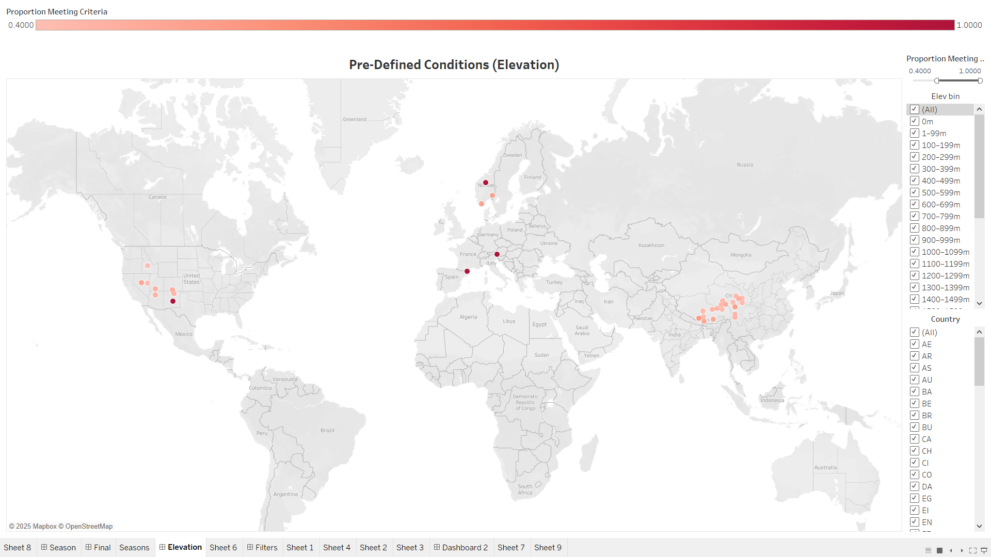
50-100% event rate
2500m+

Slide 13
Insights
🟩 Stations with Moderate Event Frequency
718 stations (5.5%) recorded ≥20% of days with relevant weather conditions.
These are primarily located in:
China
The Alps
Scandinavia
Western United States
Of these 719 stations:
43% are located below 1,000 meters (notably in Canada).
11% are located below 500 meters (notably in South Korea, Northeast USA, and Scandinavia).
📌 See Slide 12 for details.

Slide 14
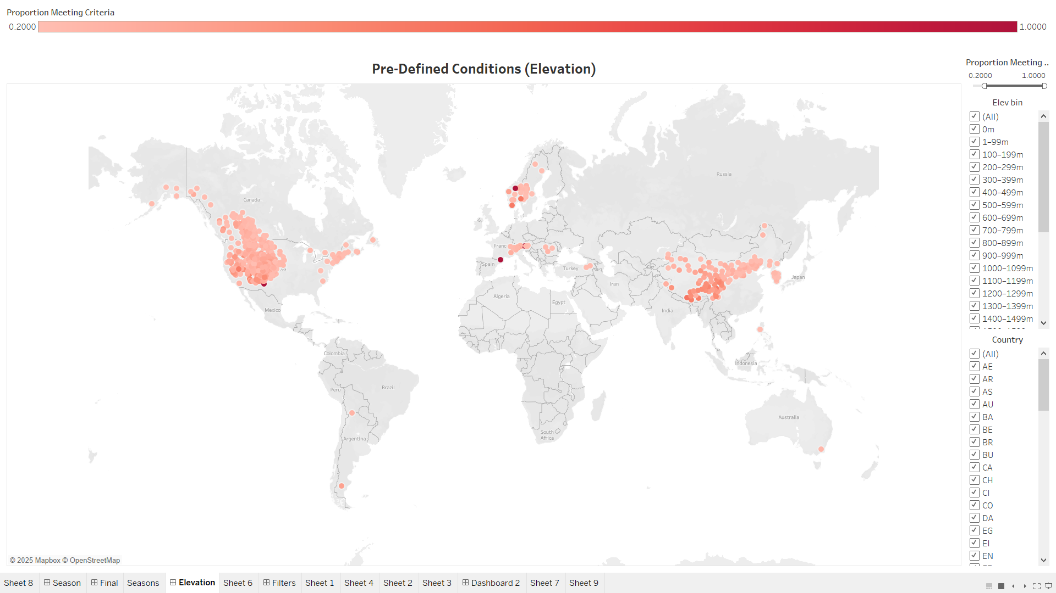

Slide 15
Insights
🟦 Stations with Low but Non-Zero Event Frequency
9,151 stations (70%) recorded at least one instance of relevant weather conditions (up to 20% of days).
10% of these are located above 1,000 meters.
20% are located above 500 meters.
📌 See Slide 13 for details.

Slide 16
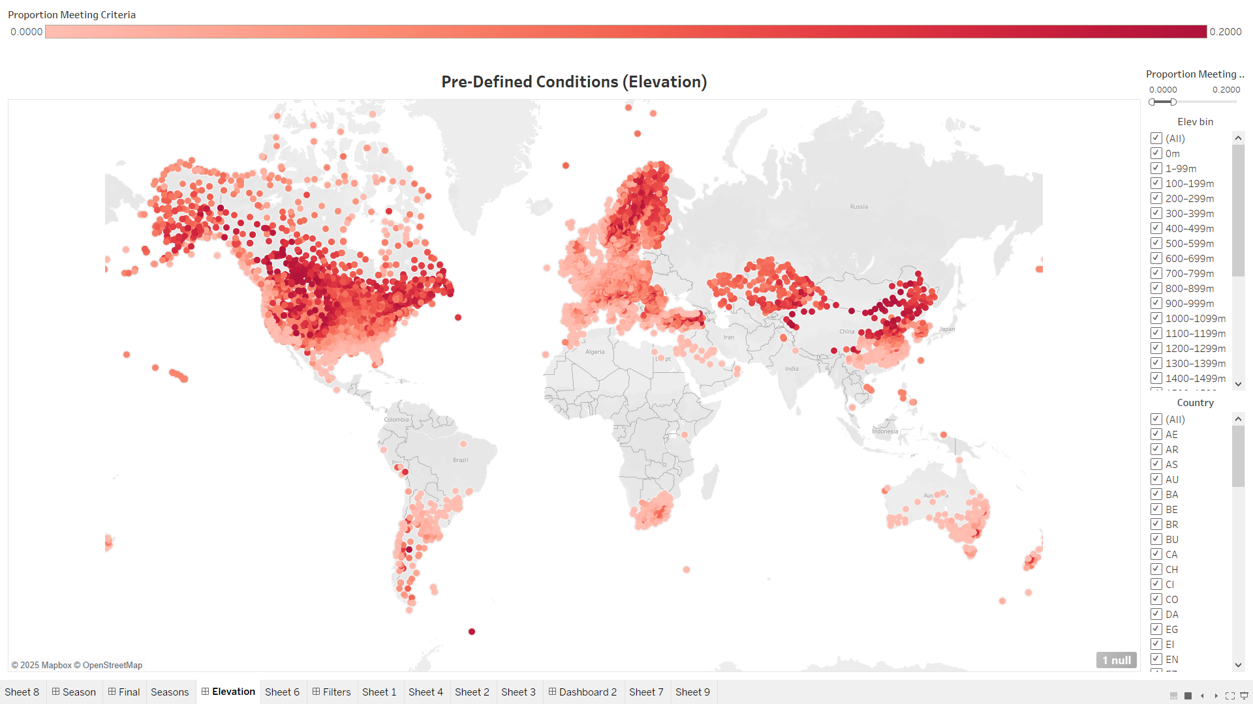

Slide 17
Insights
🟥 Stations with No Relevant Weather Events
3,231 stations (27%) recorded 0% of the target weather conditions.
These include stations in coastal regions of:
North and South America
Brazil
Africa
South and Southeast Asia
Oceania
📌 See Slide 10 for details.

Slide 18
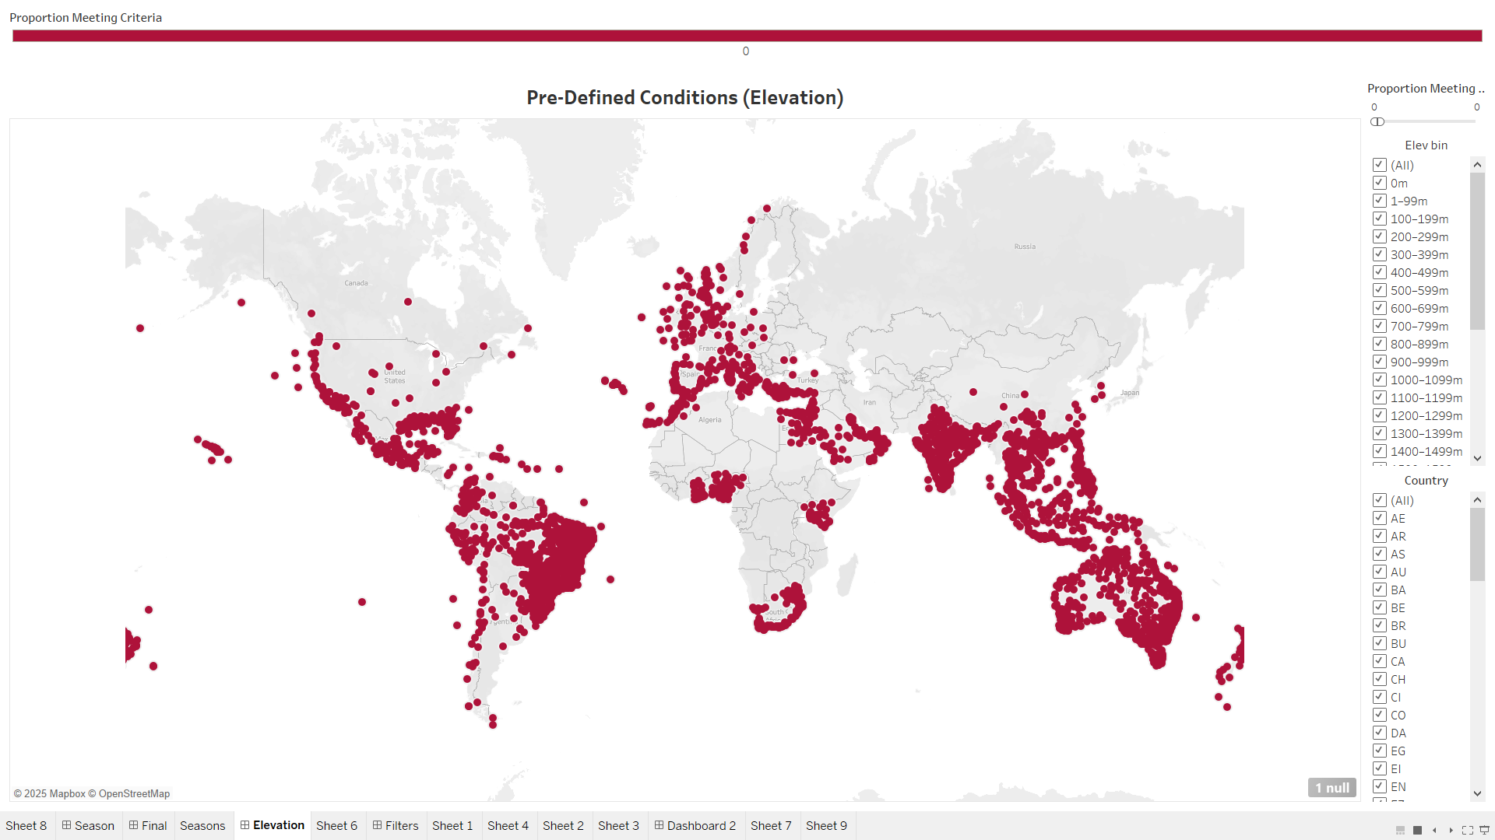

Slide 19
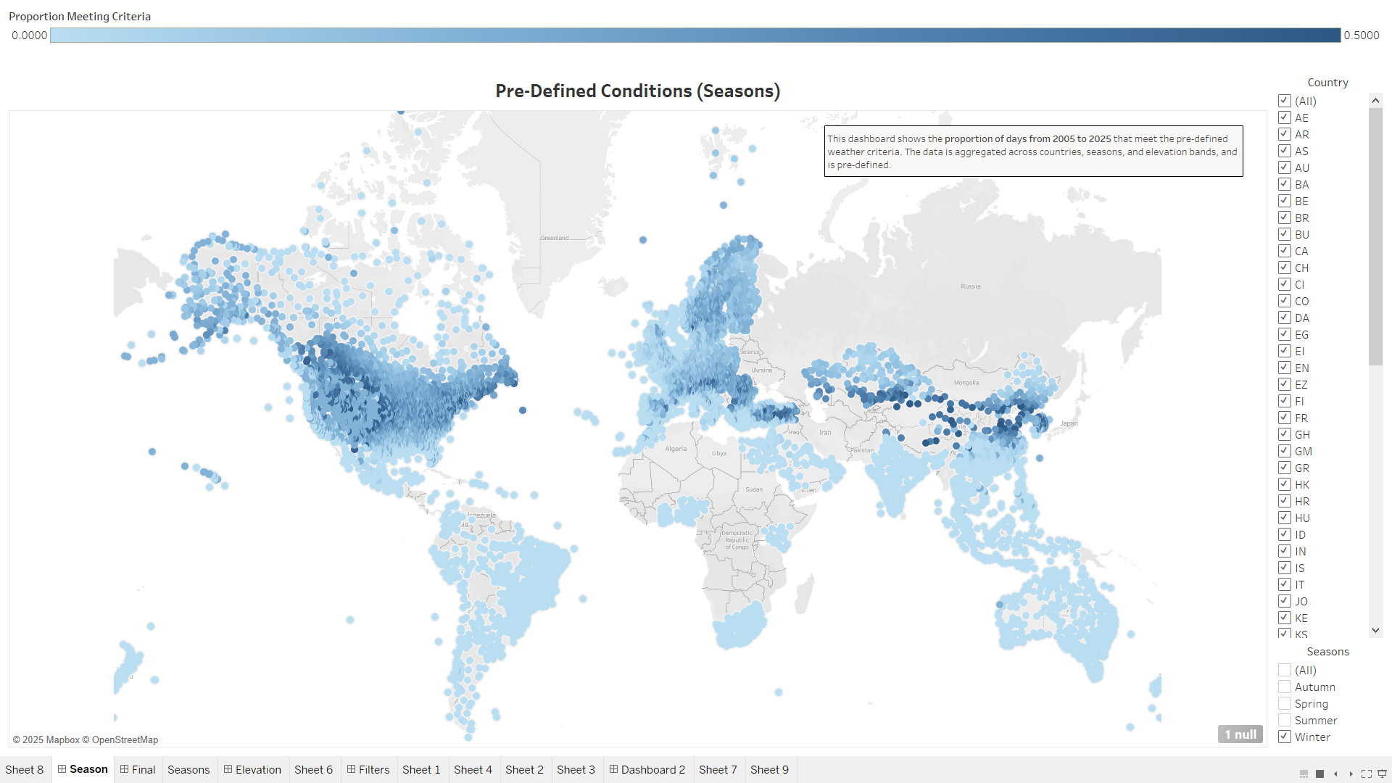
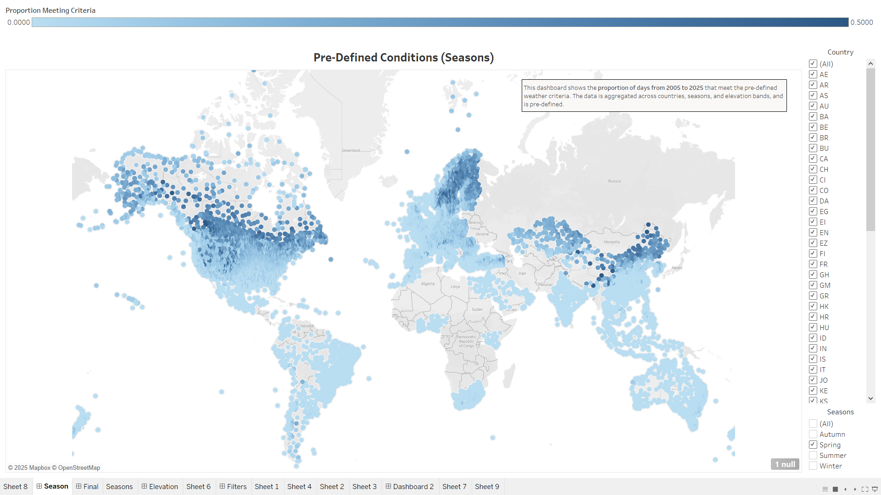
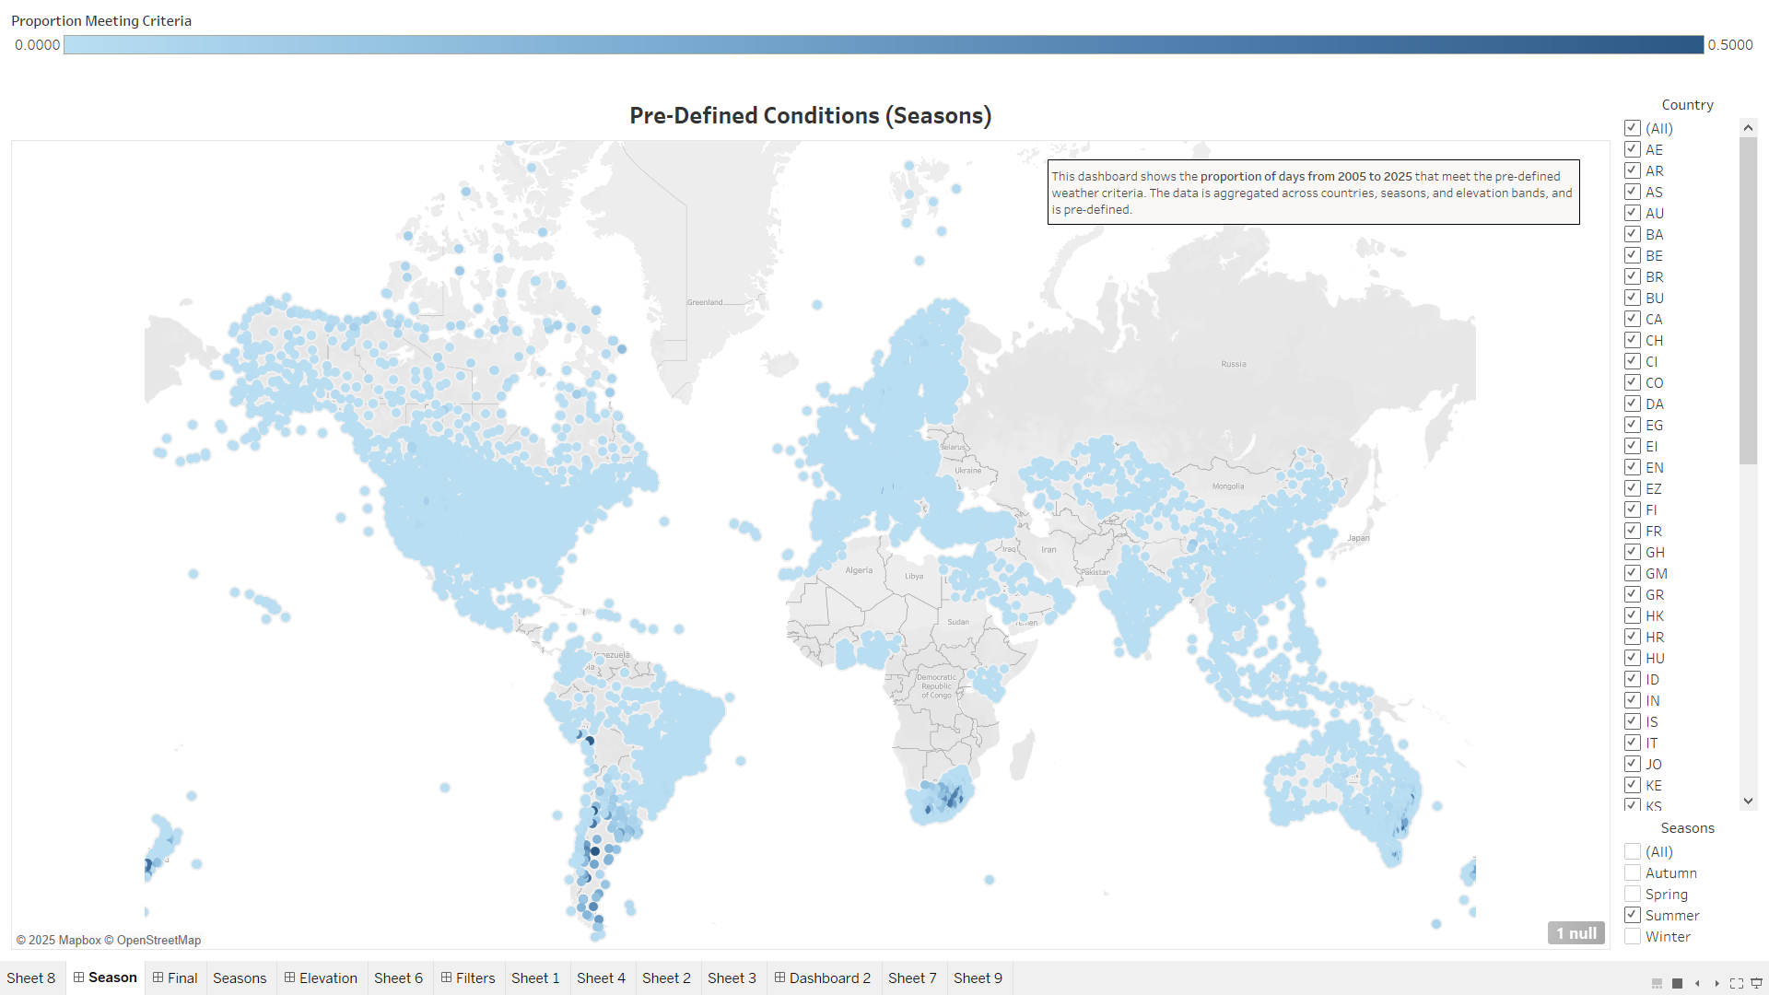
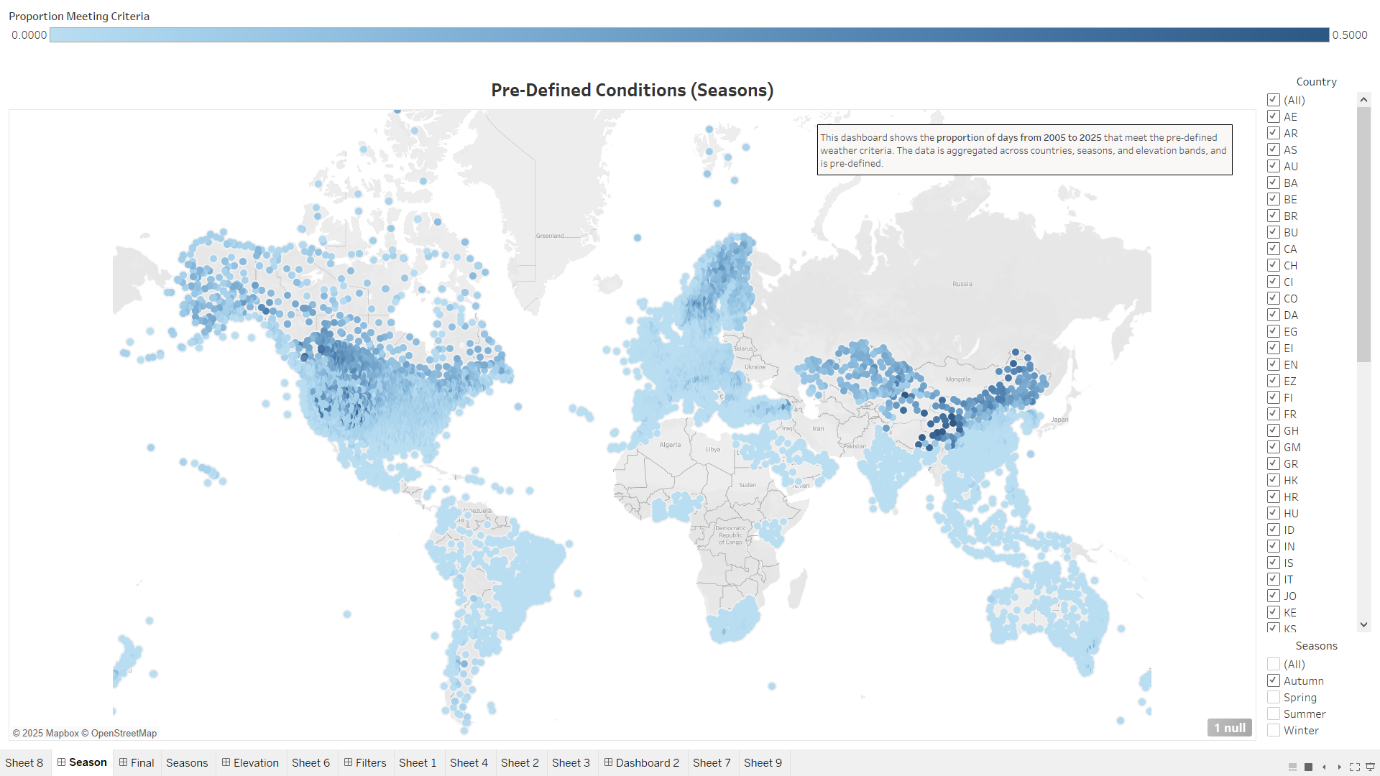
Winter
Spring
Summer
Autumn

Slide 20

Conclusions
This analysis of global weather station data from 2005 to 2025 reveals key environmental patterns that influence the risk of vane freezing in JLR vehicles. Freezing conditions are most common in winter and at higher elevations, particularly in regions like Scandinavia, the Alps, and Northern China. Conversely, summer months show minimal freezing risk, except in Southern Hemisphere countries like Australia and South Africa, where seasons are reversed.
Freeze-thaw cycles, which can stress mechanical components, are frequent in transitional seasons and mid-elevation zones. Moisture indicators such as dew point and precipitation further refine high-risk scenarios, especially when paired with sub-zero temperatures. While 27% of stations recorded no freezing events, a small subset showed frequent or extreme conditions, often due to short data spans or unique local climates.
This information, when combined with customer data, will now be used to inform design improvements in JLR vehicles, ensuring they are better equipped to endure the environmental conditions they may face globally.

